Slide 1
unibz – Faculty of Computer Science
Bachelor Thesis 21 July 2017
Studying the Change Impact of Self-Admitted Technical Debt for Reverting / Upgrading Software Versions
in Emergent Systems of Systems
Marta Pancaldi
Supervisor: Prof. Barbara Russo

Slide 2
SUMMARY
Idea and Approach:
Systems of Systems
Self-Admitted Technical Debt
Study Design
Analysis and Results

Slide 3
Main Idea
Is a newer version of code that maintains the same functionalities always better?

Slide 4
Emergence in Systems of Systems

Slide 5
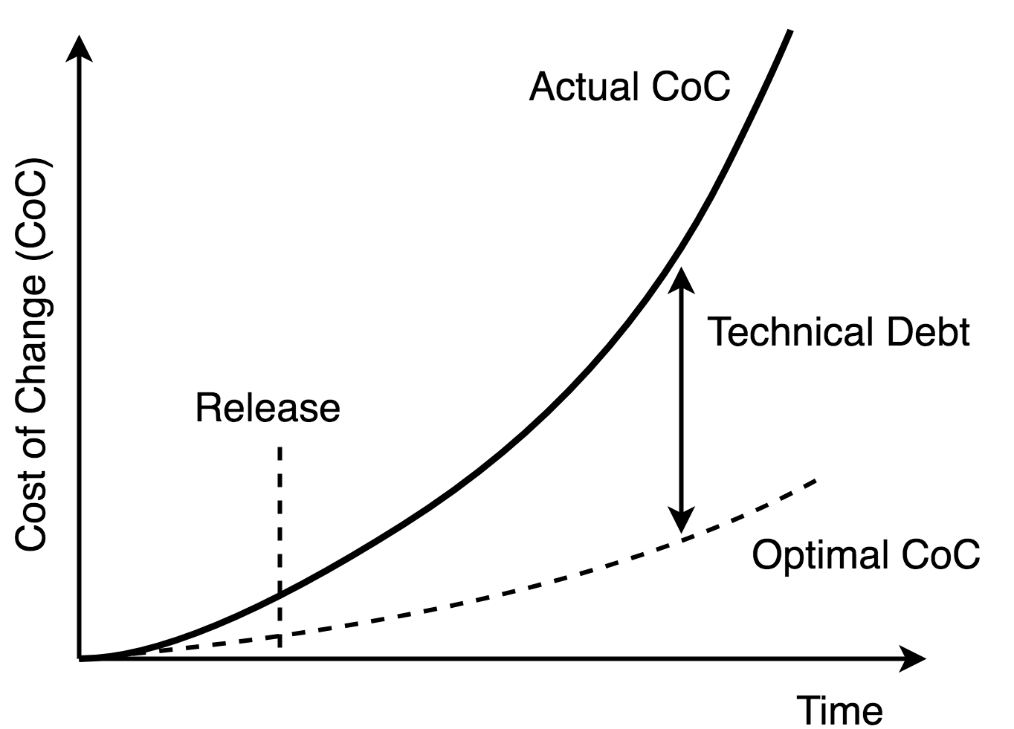
Technical Debt
Coined by W. Cunningham as metaphor of financial debt ¹
Prefer an easy, fast solution to a better implementation that requires more time
Can be intentional or unintentional
¹ W. Cunningham, “The WyCash Portfolio Management System”,
Proceedings on Object-oriented Programming Systems, Languages and Applications (OOPSLA '92)

Slide 6
Self-Admitted Technical Debt (SATD)
Self-Admitted: documented in source code comments
Voluntary, often a trade-off between quality (e.g. performance, good design) and profit (meet deadlines, lower production cost, deliver software faster to the market)
Many categories: Requirement, Documentation, Test, Design…
//TODO: should move to a separate public class
//HACK: just to help out during the load (ugly, i know)

Slide 7
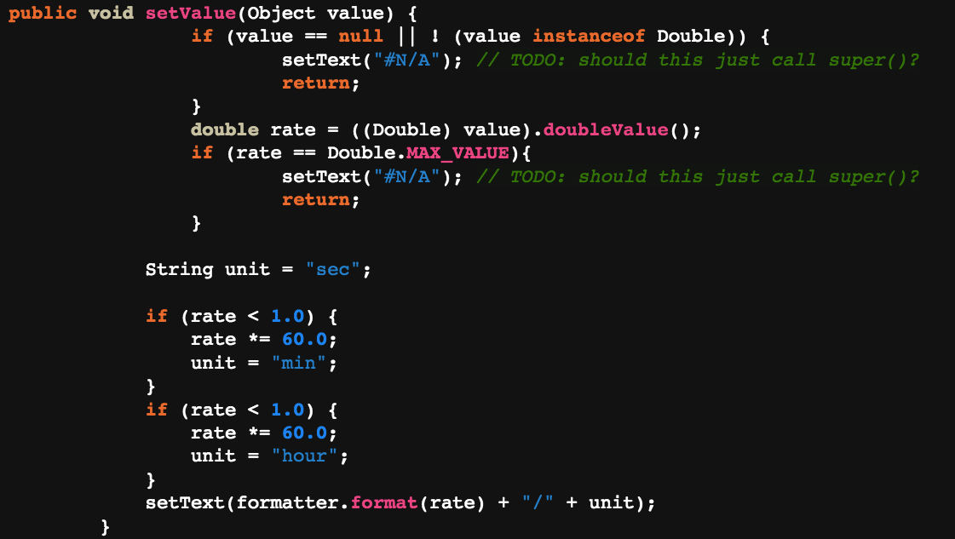
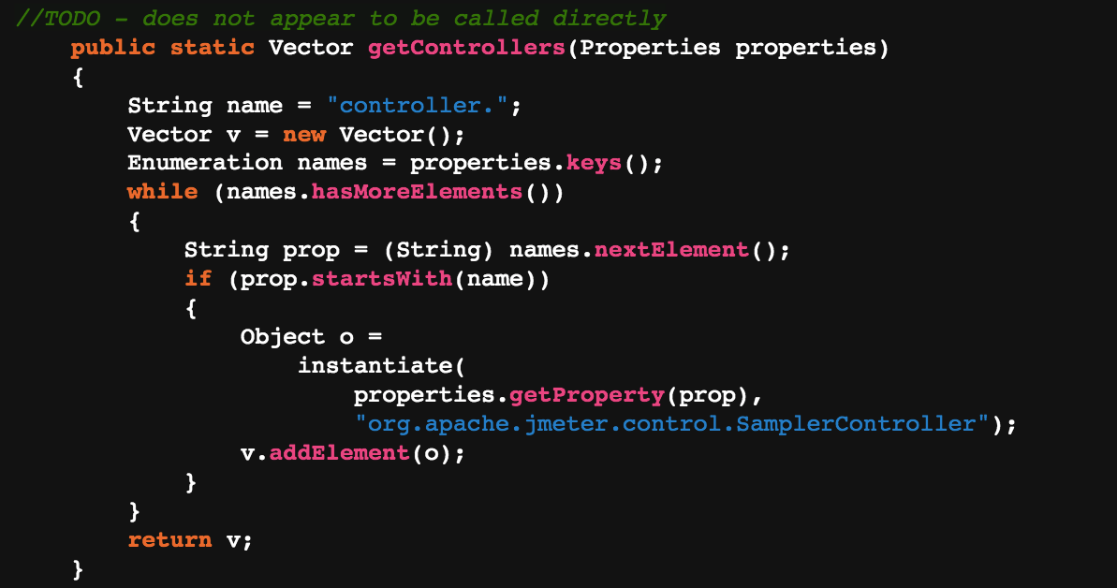
SATD-methods
SATD-comment outside the method
SATD-comment inside the method

Slide 8
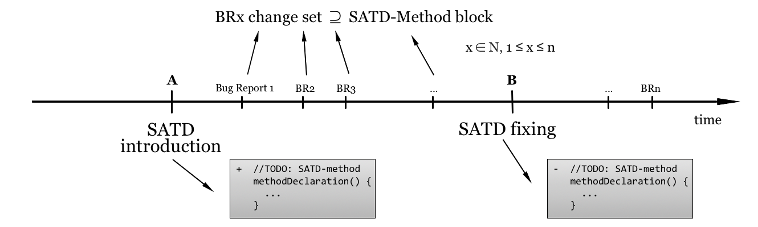
Study Design: SATD in source code
Source DBs:
Version Control System (Git)
Bug Tracking System (Bugzilla, JIRA)

Slide 9
Data Extraction & Tools
350 Design SATD from four open-source projects ²
^{GIT TOOLS}
Git Log: retrieve introductory and fixing commits of each SATD
Git Show: extract code as it was at version X
Git Diff: obtain change set between two versions of code
² E. Maldonado and E. Shihab, “Detecting and quantifying different types of self-admitted technical Debt”, 2015 IEEE 7th International Workshop on Managing Technical Debt (MTD)

Slide 10
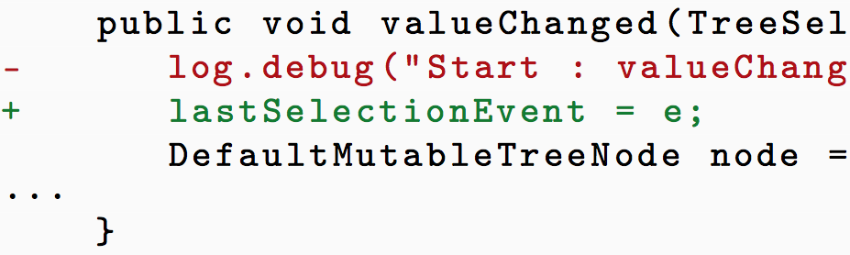
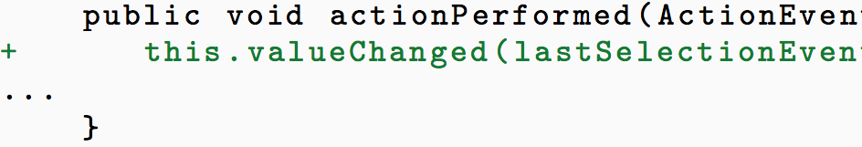
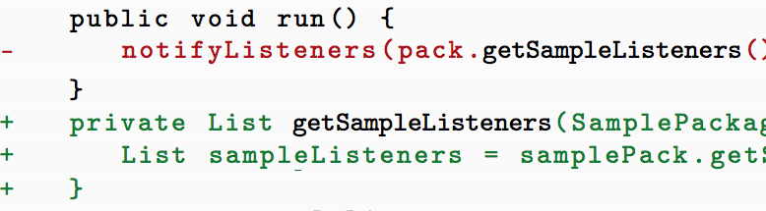
Data Extraction & Tools
CUSTOM JAVA TOOLS
Extract SATD-method block from introduction and fixing commits using SATD-comment
Identify SATD-related changed lines in BR-fixing change set, based on rules:
Lines changed within SATD-method
Lines changed containing calls of SATD-method from other methods
Lines changed within other methods called from SATD-method

Slide 11
Research Questions
RQ1: Change Impact of SATD-Introduction and Fixing
What is the relation between the code changed at SATD- introduction and the code changed at SATD-fixing?
RQ2: SATD-related Bug Reports
By fixing a SATD, does the code quality increase with respect to the time when the SATD was introduced?
RQ3: Evolution of SATD-Methods
How does a method M when a SATD is introduced evolves into M′, the same method when the SATD has been fixed?

Slide 12
Research Questions
RQ1: Change Impact of SATD-Introduction and Fixing
What is the relation between the code changed at SATD- introduction and the code changed at SATD-fixing?
RQ2: SATD-related Bug Reports
By fixing a SATD, does the code quality increase with respect to the time when the SATD was introduced?
RQ3: Evolution of SATD-Methods
How does a method M when a SATD is introduced evolves into M′, the same method when the SATD has been fixed?

Slide 13
Research Questions
RQ1: Change Impact of SATD-Introduction and Fixing
What is the relation between the code changed at SATD- introduction and the code changed at SATD-fixing?
RQ2: SATD-related Bug Reports
By fixing a SATD, does the code quality increase with respect to the time when the SATD was introduced?
RQ3: Evolution of SATD-Methods
How does a method M when a SATD is introduced evolves into M′, the same method when the SATD has been fixed?

Slide 14
Results – RQ1
Comparison between change impact at SATD-introduction vs. SATD-fixing
Change impact (at a version X) = lines changed ∩ lines in SATD-method at version X
43-67% of SATD instances: larger impact at SATD-fixing
24-37%: larger impact at SATD-introduction

Slide 15
Results – RQ1
Comparison between change impact at SATD-introduction vs. SATD-fixing
Change impact (at a version X) = lines changed ∩ lines in SATD-method at version X
43-67% of SATD instances: larger impact at SATD-fixing
24-37%: larger impact at SATD-introduction
⇒ Design Debt: code can be quick and dirty at SATD-introduction, while it must be accurate at fixing, so requires more effort

Slide 16
Results – RQ2
Compare BRs found between SATD-introduction and fixing vs. between fixing and present time
53-80% of SATD instances: more bugs in “SATD-phase”
14-30%: more bugs after fixing

Slide 17
Results – RQ2
Compare BRs found between SATD-introduction and fixing vs. between fixing and present time
53-80% of SATD instances: more bugs in “SATD-phase”
14-30%: more bugs after fixing
⇒ Presence of SATD caused more bugs in most cases
⇒ but also more Bugs after fixing in some cases

Slide 18
Results – RQ3
Compare sizes of SATD-methods at SATD-introduction vs. fixing
26-31% of SATD-instances: methods shrink
11-24%: methods grow
42-50%: methods are completely removed or renamed
3-9%: methods do not change
0

Slide 19
Results – RQ3
Compare sizes of SATD-methods at SATD-introduction vs. fixing
26-31% of SATD-instances: methods shrink
11-24%: methods grow
42-50%: methods are completely removed or renamed
3-9%: methods do not change
⇒ SATD-methods are often removed and replaced by improved versions, due to general design refactoring
0

Slide 20
Interpretation & Future Work
More expensive to pay back Design Technical Debt in most cases
Generally more Bugs before SATD-fixing
Most methods containing SATD are removed or renamed

Slide 21
Interpretation & Future Work
More expensive to pay back Design Technical Debt in most cases
Generally more Bugs before SATD-fixing
Most methods containing SATD are removed or renamed
First attempt to classify cases with larger Change Impact at SATD- intro and with more Bugs after fixing: no general causes found ⇒ Investigate to find causes ⇒ Study and apply automated update / downgrade based on presence of Design SATD in SoS

Slide 22
Thanks

Slide 23
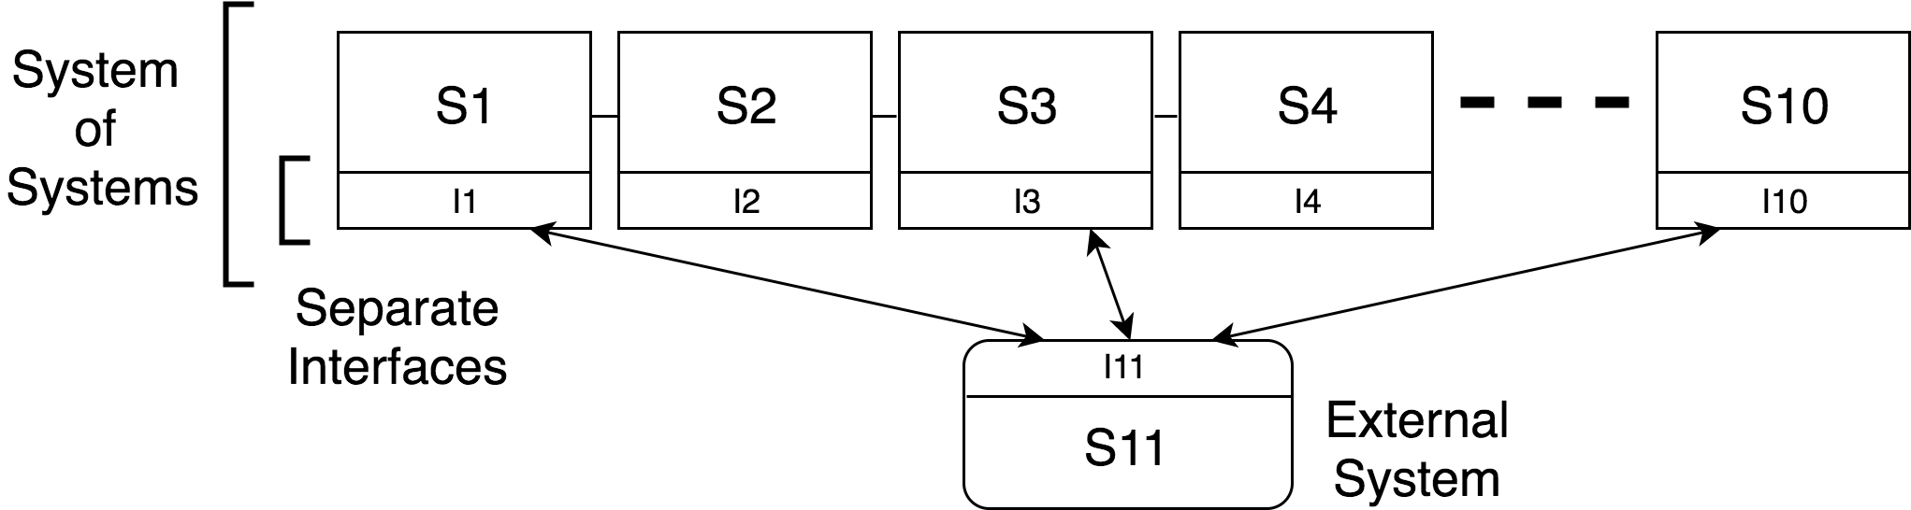
Example: Emergence in SoS & Design changes

Slide 24
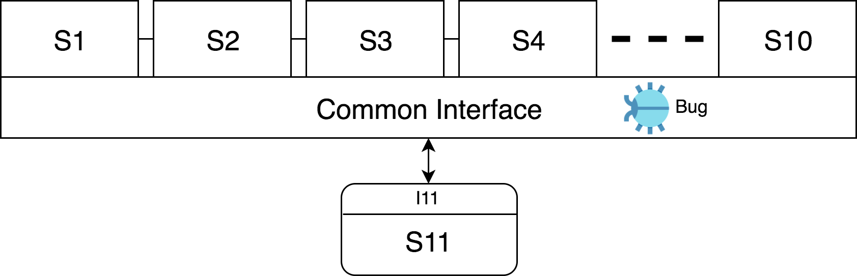
Example: Emergence in SoS & Design changes

Slide 25
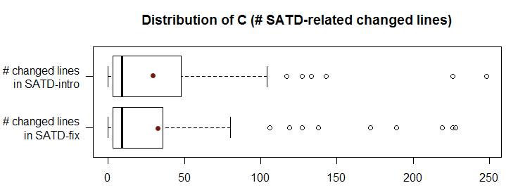
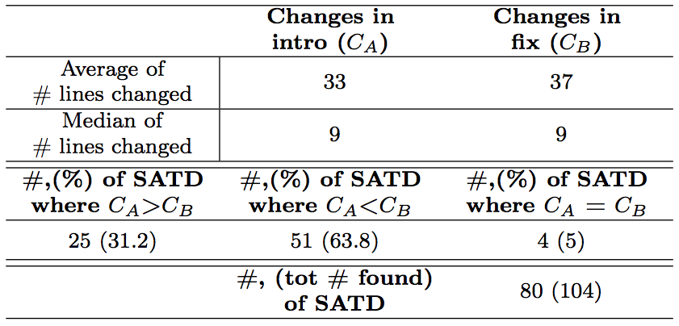
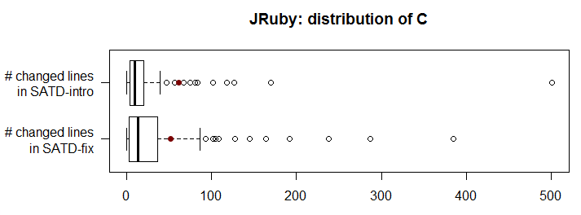
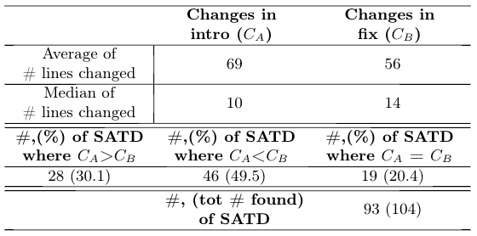
RQ1 – Change Impact
JMeter:

Slide 26
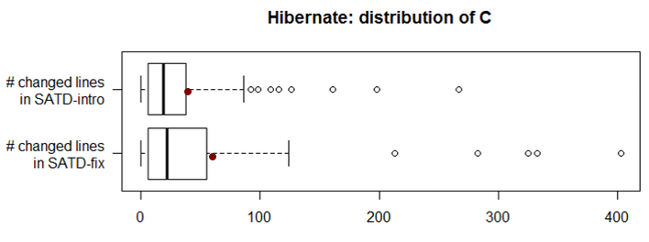
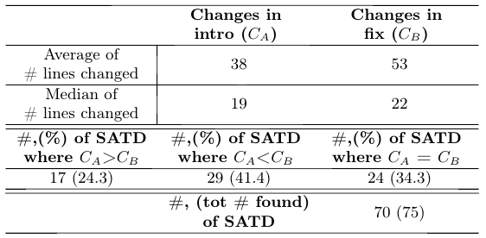
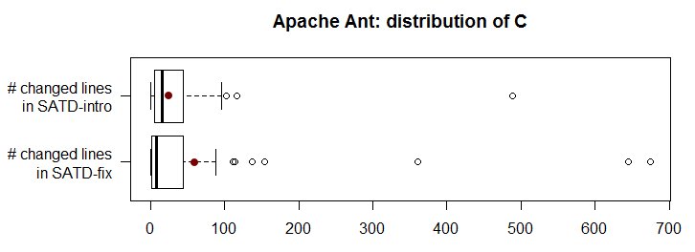
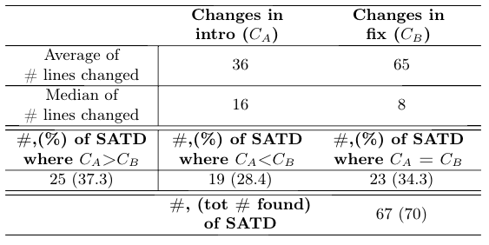
RQ1 – Change Impact

Slide 27
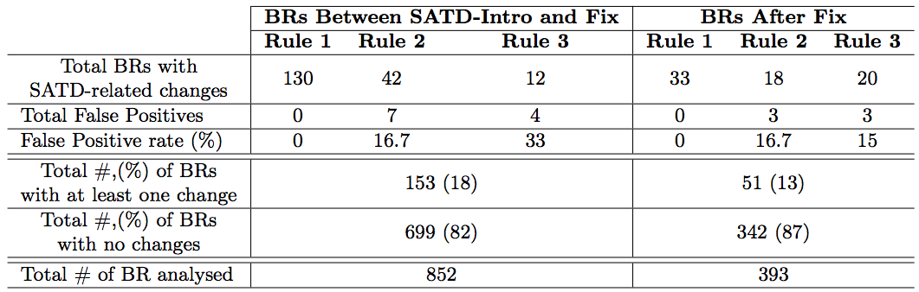
RQ2 – BRs identified by three rules in JMeter

Slide 28
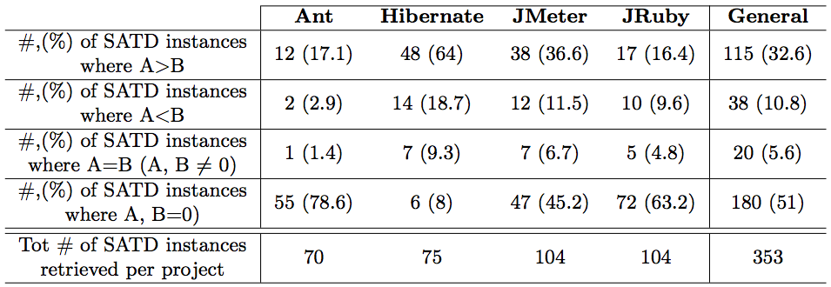
RQ2 – BRs after SATD-introduction vs. after fixing
A = # of BRs found between SATD-introduction and fixing B = # of BRs found after SATD-fixing

Slide 29
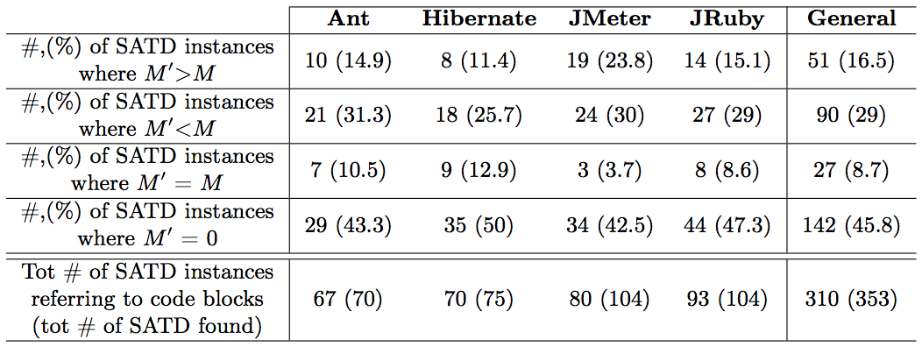
RQ3 – Evolution of SATD-methods

Slide 30
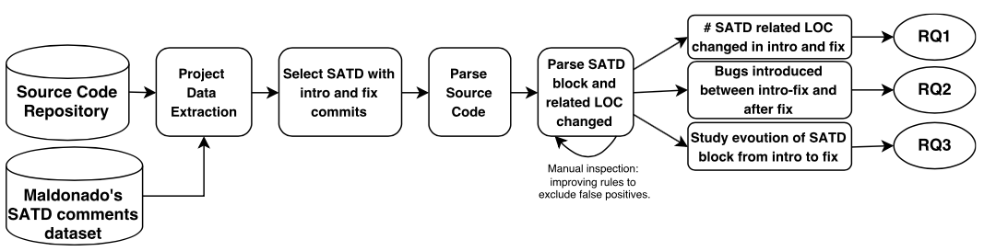
Activity Diagram

